Slide 1
CS118 – Programming Fundamentals
Lecture # 13
Monday, October 07, 2019
FALL 2019
FAST – NUCES, Faisalabad Campus
Course Instructor:
Ebad Majeed
Slides Credit:
Rizwan Ul Haq

Slide 2
for Looping (Repetition) Structure
The general form of the for statement is:
The initial statement, loop condition, and update statement are called for loop control statements
initial statement usually initializes a variable (called the for loop control, or for indexed variable)
In C++, for is a reserved word

Slide 3
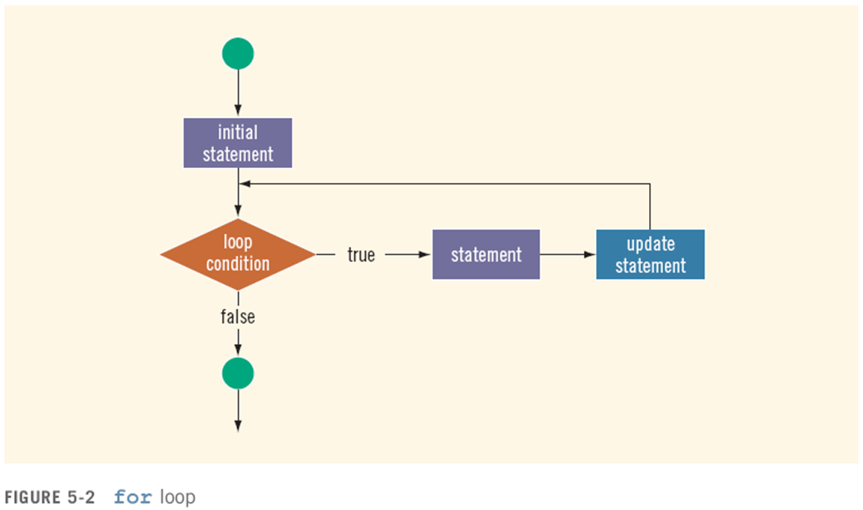
for Looping (Repetition) Structure (cont'd.)

Slide 4
for Loop Example
int sum = 0, num;
for (num = 1; num <= 10; num++)
sum += num;
cout << "Sum of numbers 1 – 10 is "
<< sum << endl;

Slide 5
More for Loop
The following for loop output Hello! And a star (on separate lines) five times
for (i = 1; i <= 5; i++)
{
cout << "Hello!" << endl;
cout << "*" << endl;
}
Consider the following for loop
for (i = 1; i <= 5; i++)
cout << "Hello!" << endl;
cout << "*" << endl;
This loop outputs Hello! Five times and the star only once. Note that the for loop controls only the first output statement because the two output statements are not made into a compound statement. Therefore, the first output statement executes five times because the for loop body executes five times. After the for loop executes, the second output statement executes only once. The indentation, which is ignored by the compiler, is nevertheless misleading.

Slide 6
More for Loop
The following for loop executes five empty statements:
for (i = 0; i < 5; i++); //Line1
cout << "*" << endl; //Line2
The semicolon at the end of the for statement (before the output statement, Line) terminates the for loop. The action of this for loop empty, that is, null

Slide 7
for Loop Notes
If test is false the first time it is evaluated, the body of the loop will not be executed
The update expression can increment or decrement by any amount
Variables used in the initialization section should not be modified in the body of the loop

Slide 8
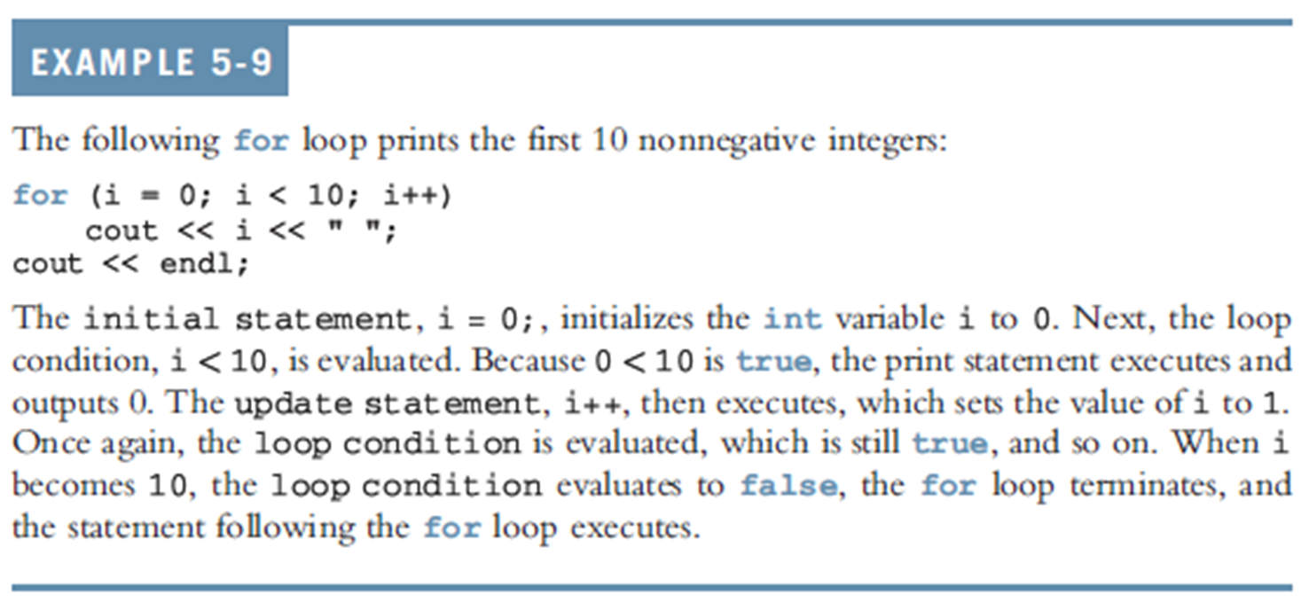
for Looping (Repetition) Structure (cont'd.)

Slide 9
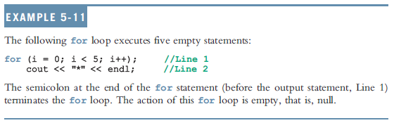
for Looping (Repetition) Structure (cont'd.)
C++ allows you to use fractional values for loop control variables of the double type
Results may differ
The following is a semantic error:
The following is a legal for loop:
for(;;)
cout << "Hello " << endl;

Slide 10
More for Loop
1. Consider the following for loop
for(int i = 10 ; i <= 9 ; i++)
cout << i << " " ;
cout << endl;
In this for loop initial statement sets i to 10. Because initially the loop condition (i <= 9) is false. Nothing happens.
2. Consider the following for loop
for(int i = 9 ; i >= 10 ; i--)
cout << i << " " ;
cout << endl;
In this for loop initial statement sets i to 9. Because initially the loop condition (i >= 10) is false. Nothing happens.
3. Consider the following for loop
for(int i = 10 ; i <= 10 ; i++) //Line 1
cout << i << " " ; //Line 2
cout << endl; //Line 3
In this for loop initial statement sets i to 10. Because initially the loop condition (i <= 10) is true, so the output statement in Line 2 executes, which outputs 10

Slide 11
4. Consider the following for loop
int i;
for(i = 1 ; i <= 10 ; i++); //Line 1
cout << i << " " ; //Line 2
cout << endl; //Line 3
This for loop has no effect on the output statement in line 2. The semicolon at the end of the for loop ends the for loop; the action of the for loop is thus empty. The output statement is all by itself and hence runs only once.
5. Consider the following for loop
for(int i = 1 ; ; i++)
cout << i << " " ;
cout << endl;
In this for loop because the loop condition is omitted from the for statement, the loop statement is always true. This is an infinite loop.

Slide 12
for Loop Modifications
Can define variables in initialization code
Their scope is the for loop
Initialization code, test, or update code can contain more than one statement
Separate statements with commas
Example:
for (int sum = 0, num = 1; num <= 10; num++)
sum += num;

Slide 13
More for Loop Modifications (These are NOT Recommended)
Can omit initialization if already done
int sum = 0, num = 1;
for (; num <= 10; num++)
sum += num;
Can omit update if done in loop
for (sum = 0, num = 1; num <= 10;)
sum += num++;
Can omit test – may cause an infinite loop
for (sum = 0, num = 1;; num++)
sum += num;

Slide 14
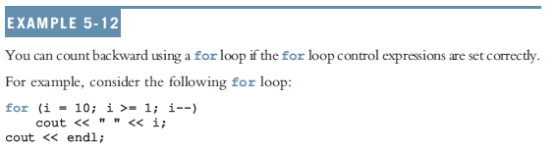
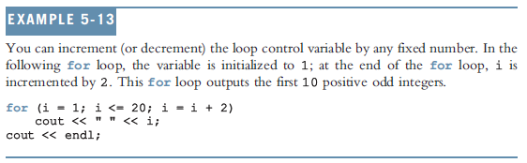
for Looping (Repetition) Structure (cont'd.)

Slide 15
Example
Revise the Fibonacci numbers using for loop.

Slide 16
Example
for (int previous1 = 1, previous2 = 1, counter = 3, current ; counter <= nthFibonacci ; counter++)
{
current = previous2 + previous1;
previous1 = previous2;
previous2 = current;
}//end for

Slide 17
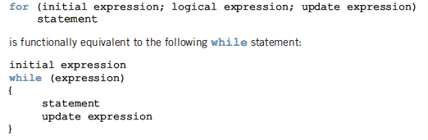
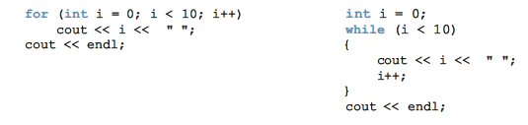
for Vs while

Slide 18
Questions

